Slide 1

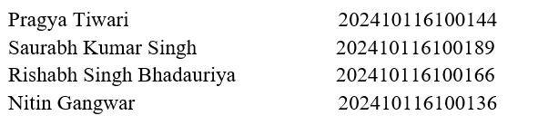
AI-I (AI101B) Even Semester Session 2024-25
HealthCare Data Cleaning
Submitted By:
Project Supervisor:
Mrs. Komal Salgotra
Notes:
“Good morning everyone! We are here to present our project on Healthcare Data Cleaning which focuses on how clean data can dramatically improve the healthcare industry.”

Slide 2
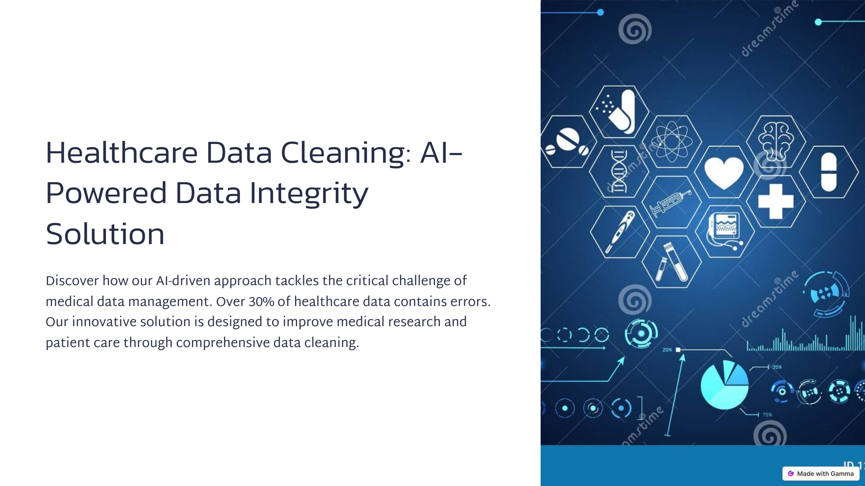
Introduction
Notes:
“To begin with, let’s understand what healthcare data cleaning is. It involves identifying and correcting or removing inaccurate records from a dataset. Since healthcare data comes from various sources like EHRs, labs, and wearable devices, it's crucial to make it clean and consistent before analysis.”

Slide 3
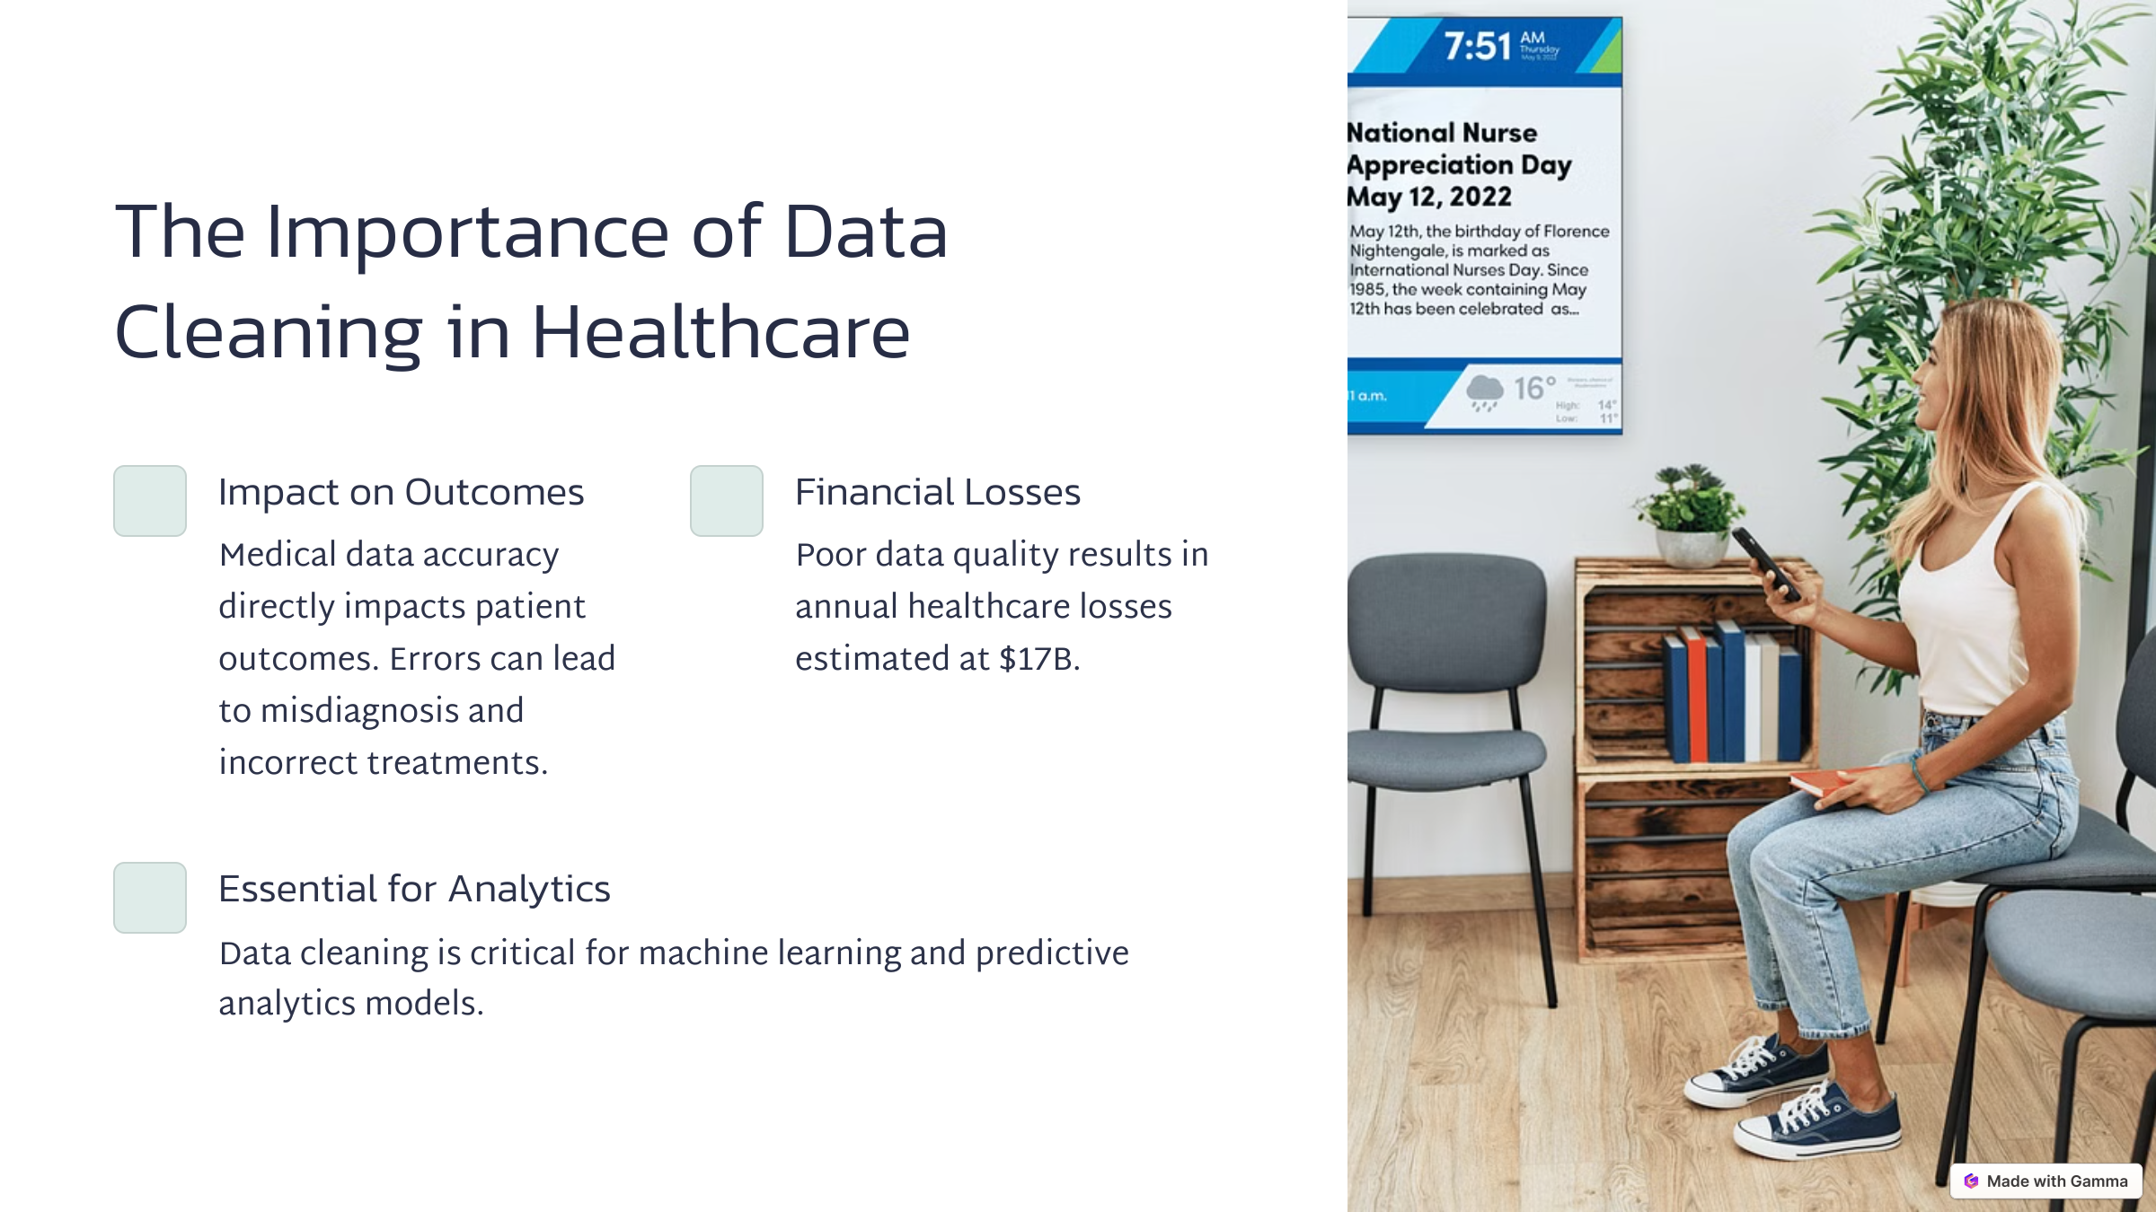
Importance
Notes:
Why is this important? Unclean data can lead to poor clinical decisions, wrong patient treatment, or even failed medical research. Let’s say an algorithm is trained to detect early-stage cancer but is based on flawed or missing data—it may give inaccurate predictions. Clean data ensures:
Better diagnoses
Accurate machine learning results
Faster and error-free hospital operations Ultimately, it can save lives by supporting evidence-based care."
🎯 Tips:
Let your voice drop slightly on save lives for impact.
Use statistics or quick facts if you want to be extra persuasive.

Slide 4
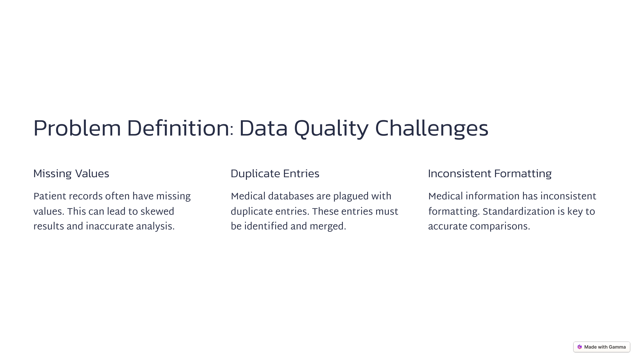
Problem Definition
Notes:
What to Say:
"The core problems in raw healthcare datasets include:
Missing values – which can skew results or cause models to fail.
Duplicate records – like the same patient appearing twice.
Inconsistent categories – such as 'Male', 'M', and 'm' being treated as different.
Outliers – like someone with a blood pressure reading of 400/200, which is physiologically impossible. These inconsistencies make it hard to analyze or derive meaningful insights."
🎯 Tips:
Mention that healthcare data can be life-critical, hence accuracy is non-negotiable.
Use humor lightly to explain inconsistency (e.g., “Even AI gets confused if you feed it ‘m’, ‘M’, and ‘Male’ for the same thing”).

Slide 5
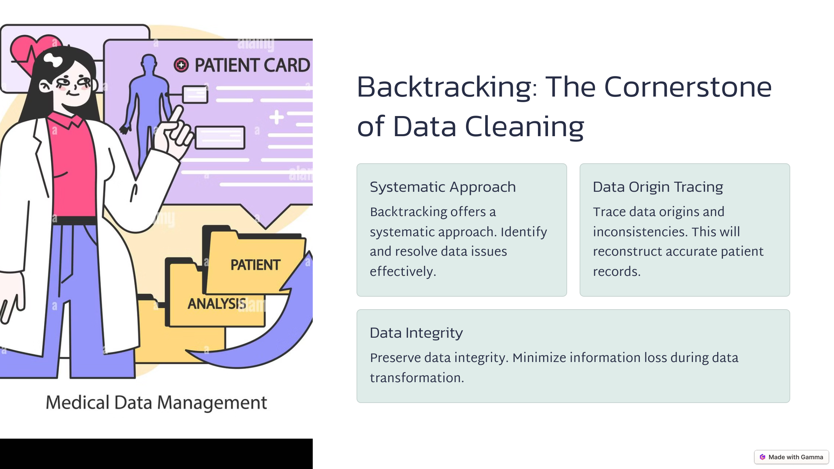
Why Backtracking?
Notes:
Backtracking is generally used in algorithm design when we want to explore all possible solutions and undo decisions when they lead to failure. In data cleaning, we used backtracking as part of validation—for example, to validate date fields, or to recursively check categorical entries. If an entry doesn’t follow a certain rule, backtracking helps us revert to a previous clean state, making the approach logical and fault-tolerant."

Slide 6
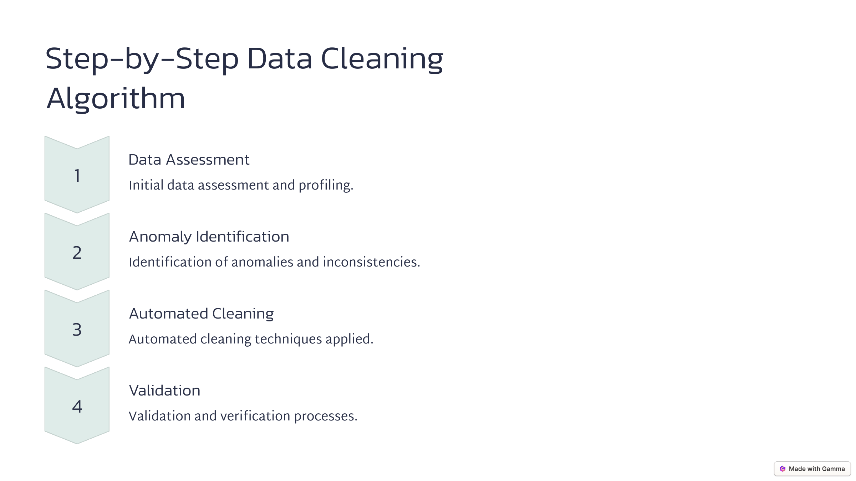
Step-by-Step Algorithm

Slide 7

Code Implementation (Python)
Notes:
We used Python and key libraries like Pandas, NumPy, and Seaborn. For instance:
df.dropna() removes rows with missing values.
df.duplicated() flags repeated records.
Categorical standardization was done using .replace() and .map(). Each function was tested on sample datasets and optimized for real-world scale. Here's a sample function:

Slide 8
Real-World Applications
1. Electronic Health Records (EHR) Management
Ensures accurate and consistent patient records for better clinical decision-making.
Reduces errors caused by missing or duplicate patient data.
2. Medical Research & Clinical Trials
Clean data enhances the quality of epidemiological studies and drug efficacy trials.
Helps researchers analyze disease patterns more effectively.
3. Predictive Analytics in Healthcare
Improves early disease detection and risk assessment using machine learning models.
Clean data enables hospitals to predict patient readmission rates and treatment outcomes.
4. Hospital & Insurance Operations
Prevents billing errors in health insurance claims processing.
Reduces redundant data entries, optimizing hospital resource management.
5. Wearable Health Devices & Remote Monitoring
Ensures accurate patient vitals tracking (heart rate, blood pressure, glucose levels).
Helps doctors and AI models make data-driven decisions for patient care.
Notes:
Clean data makes a real-world difference:
EHR Management – Helps maintain consistent patient history.
Medical Research – Clean datasets ensure reliable trial results.
Predictive Analytics – Accurate data boosts model performance for early disease detection.
Hospital & Insurance Operations – Clean data prevents billing errors, optimizes staff scheduling.
Wearable Devices – Ensures that AI-powered vitals monitoring systems give real-time, reliable data."

Slide 9
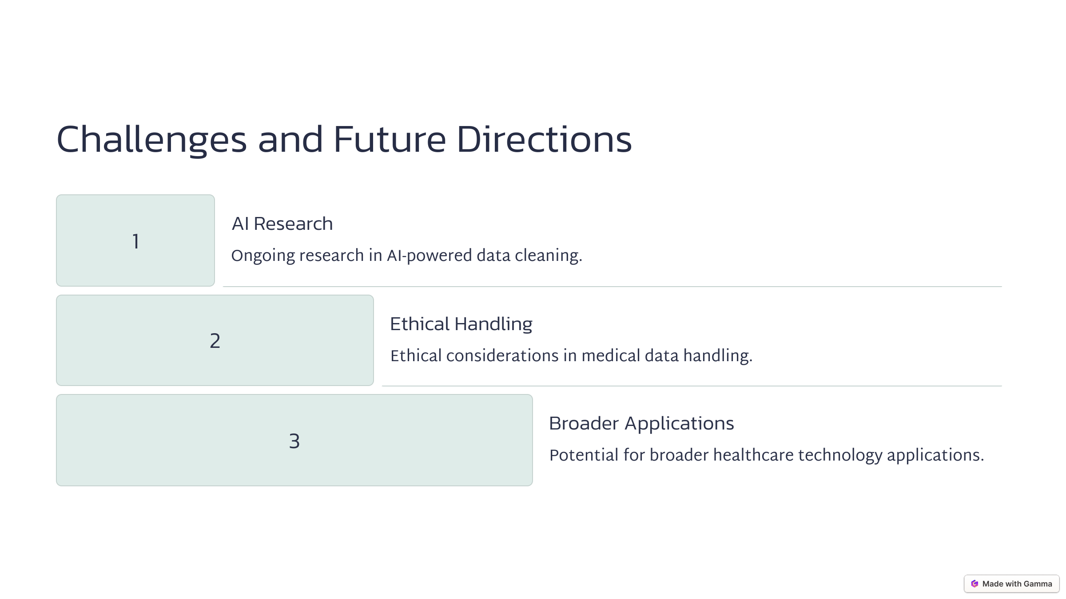
Challenges and Future Scope
Notes:
Challenges include:
Inconsistent data entry practices
Lack of standardized formats
Privacy and security concerns while handling real patient data In the future, we can use:
AI/ML algorithms to automate data cleaning
Blockchain to ensure tamper-proof data tracking
NLP for unstructured data like doctor’s notes Healthcare is evolving fast, and clean data will be its foundation.

Slide 10
Conclusion
High-quality healthcare data is essential for accurate analysis,
medical decision-making, and research.
Data cleaning significantly improves the reliability and usability of
healthcare datasets.
This project successfully handled missing values, removed duplicate records,
standardized categorical data, and treated outliers.
Exploratory Data Analysis (EDA) provided valuable insights into patient
demographics and health trends.
The cleaned dataset is now suitable for further analytics, machine learning
applications, and research.
Notes:
To conclude:
Clean data is not optional—it's essential for reliable analysis and informed decisions.
Our project tackled all major cleaning tasks: missing values, duplicates, outliers, and standardization.
EDA gave us confidence that the cleaned dataset was ready for ML models and real-world use. Ultimately, this contributes to better healthcare systems and patient outcomes."

Slide 11
Thank You!

